Slide 1

College Student Life Advice
By Emiliano Sanchez and Kevin White

Slide 2
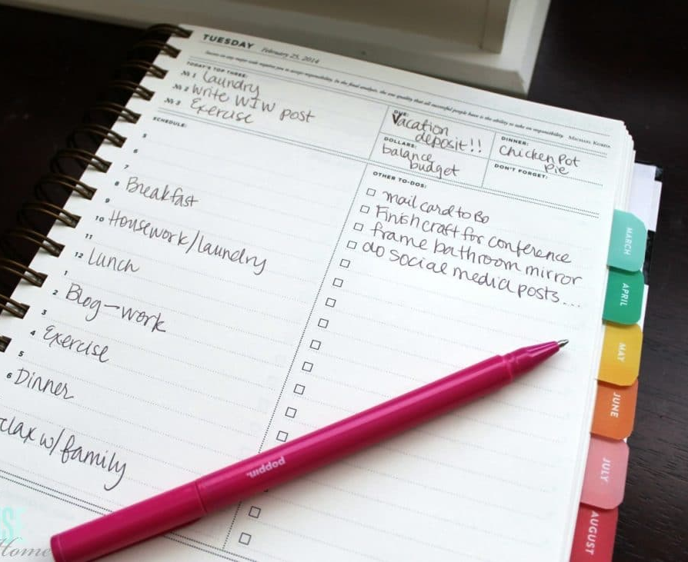
Plan Your days!
As a student you are often not only in a new environment, but you also have more responsibilities. Make a planner to help organize your classes or work schedule, and take advantage of premade calendars like on blackborad to notify yourself with due-dates and upcoming assignments
This Photo by Unknown Author is licensed under CC BY

Slide 3

Fix it fast
As soon as you have a problem in your home, whether it be the AC, bugs, or pipeline issues get it fixed asap before it gets worse. The dorms will charge you if the problem is bad enough, but putting in a work order is free, take advantage of it before it’s to late.
This Photo by Unknown Author is licensed under CC BY-SA

Slide 4

Pay of loans fast
If you need to take out loans pay them off faster and cheaper by paying more every month, this will allow you to eat away at the loan and lower the increase in interest every month and ultimately save you more money in the long run

